Slide 1
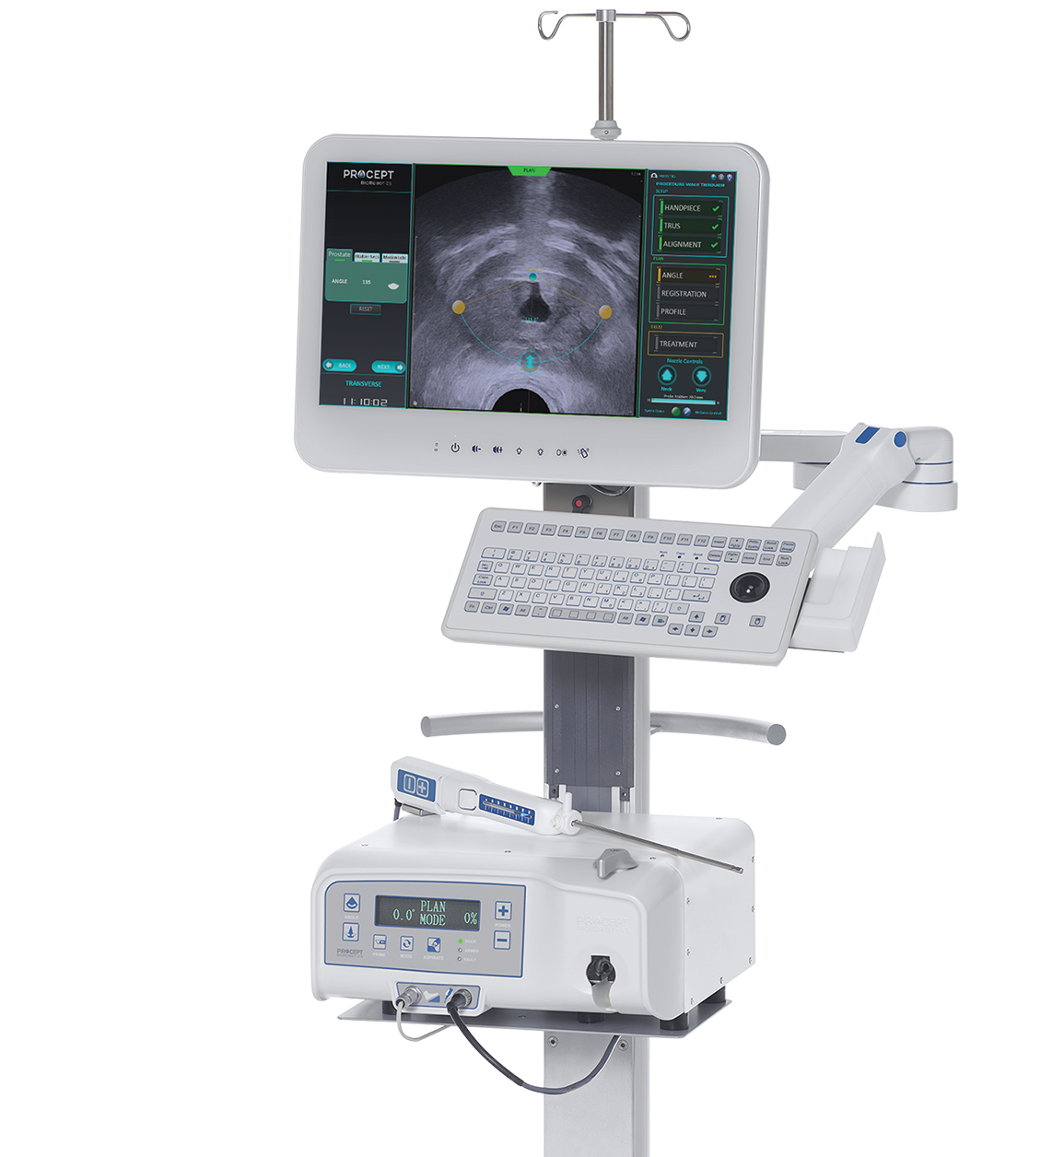
The benign prostatic hyperplasia (BPH) treatment of choice for all prostates

Slide 2

Company Timeline
ML0577.B

Slide 3









PROCEPT BIOROBOTICS
A DIFFERENT MEDICAL
DEVICE COMPANY
SECURED DEDICATED
reimbursement codes
and insurance coverage
Guidelines: BPS
(Germany) GIRFT (UK)
Guidelines:
NICE
CUA
Guidelines: NICE IPG Standard Arrangement
Medicare
Coverage
Guidelines:
NICE MIB
First AUG
approval
2017
2019
2022
2024
2018
2020
2023
FDA
Clearance
Guidelines:
NICE IPG Special Arrangement UK
Guidelines:
AUA
Guidelines:
EAU
250th AquaBeam
system placed
globally
Covered by all
large commercial payers:
95% of US men
Final AUG
modification
OUTCOMES-DRIVEN SINCE DAY 1
with robust level 1 clinical evidence spanning 5 years in the WATER and WATER II studies,
ONE OF THE FASTEST ADOPTIONS
of a medical robot
in US history
50K
procedures completed
ML0577.B
Notes:
Slide 3 (Timeline):
Let’s start with a quick overview of the Company’s history with a few key milestones since the Aquablation technology was introduced all the way through to completing 50k procedures in May 2024.
PROCEPT BioRobotics is a US-based organisation founded in 2007 in Silicon Valley.
Since CE Mark Certification in 2014 and FDA Approval in 2017 (through De Novo Classification – truly innovative/no comparator device), the Company has been on a rapid growth trajectory.
From Day 1 PROCEPT made a commitment to invest in clinical data to validate and support the technology.
Our early investment in clinical data has supported continued adoption with the 5-year results in both WATER and WATER II studies spanning small to large prostates.
Robust clinical data resulted in acceptance in society recommendations around the world, including NICE, AUA, EAU, BPS, GIRFT and AUG, which helped us achieve dedicated reimbursement and insurance coverage in both Private and Public Medical Institutions in the key markets including US, UK and Japan.
As a result of our strong clinical outcomes paired with patient access, Aquablation therapy is on pace to be the fastest adopted medical robot in US history.

Slide 4




AQUABLATION THERAPY MINIMISES THE COMPROMISE IN ALL PROSTATES
UROLOGISTS CAN TREAT MORE PATIENTS WITH A SINGLE MODALITY
UNMET NEED:
SAFETY & EFFICACY IN ALL PROSTATES
ALL SIZES, ALL SHAPES
PRIORITIZE
SEXUAL
FUNCTION & CONTINENCE
PRESERVATION
PRIORITIZE
SYMPTOM
RELIEF
SEXUAL
FUNCTION & CONTINENCE
PRESERVATION
SYMPTOM
RELIEF
small
(30-40mL)
medium
(40-80mL)
large
(80-150mL)
extra large
(150mL+)
TURP & PVP
Enucleation & Simple
NON-RESECTIVE
RESECTIVE
MIST
PVP: Photovaporization of Prostate
MIST: Minimally Invasive Surgical Technology.
BPH size ranges: AUA Guidelines: Surgical Management of BPH/Lower Urinary Tract Symptoms (2018, amended 2019, 2020) Published 2018, Amended 2019, 2020.
Tanneru et al: An Indirect Comparison of Newer Minimally Invasive Treatments for Benign Prostatic Hyperplasia: A Network Meta-Analysis Model, 2020
ML0577.B
Notes:
Slide 6 (‘Avocado’ slide):
The morphologic effects of BPH create wide variability in the size and shape of the prostate.
Historically, surgeons have been lacking a solution that could reliably and reproducibly treat all patients without a compromise to safety and efficacy.
Resective procedures, which account for about 70% of BPH procedures include TURP and Greenlight for small and medium sized prostates and laser enucleation and radical prostatectomy for the large and extra-large glands.
While resective procedures are effective and durable they come with a higher rate of irreversible complications such as sexual function and incontinence.
As a result, further procedural fragmentation has occurred with the emergence of minimally invasive treatments such as Urolift and Rezum which account for about 30% of procedures.
These treatments have a lower complication profile, but with that comes a less durable treatment to ultimately relive symptoms.

Slide 5



AQUABLATION THERAPY MINIMISES THE COMPROMISE IN ALL PROSTATES
UROLOGISTS CAN TREAT MORE PATIENTS WITH A SINGLE MODALITY
PRIORITIZE
SEXUAL
FUNCTION & CONTINENCE
PRESERVATION
PRIORITIZE
SYMPTOM
RELIEF
SEXUAL
FUNCTION & CONTINENCE
PRESERVATION
SYMPTOM
RELIEF
small
(30-40mL)
medium
(40-80mL)
large
(80-150mL)
extra large
(150mL+)
TURP & PVP
CLINICAL VALUE
Limits the compromise of safety & efficacy
Treats all prostate sizes & shapes
STRATEGIC VALUE
Helps drive Day Case surgery
Enucleation & Simple
NON-RESECTIVE
RESECTIVE
MIST
BPH size ranges: AUA Guidelines: Surgical Management of BPH/Lower Urinary Tract Symptoms Published 2018, Amended 2019, 2020.
ML0577.B
Notes:
So, the value thesis for Aquablation therapy, and this have been proven out through level-1 evidence now at 5yrs follow up, is a BPH treatment option that provides durability of symptom relief with low complication rates regardless of prostate size or shape.
What this means for patients and urologists is they no longer need to compromise safety and efficacy.
What this means for hospitals is a treatment option that can be more predictable and reproducible for ALL patients, allowing greater surgical efficiency and ability to move to Day Case surgery to reduce patient backlog.

Slide 6
Clinical Data
ML0577.B

Slide 7
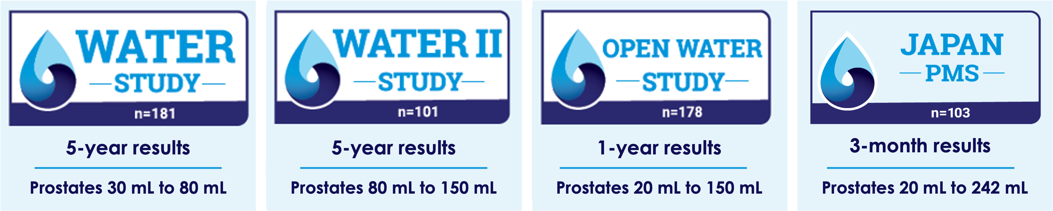

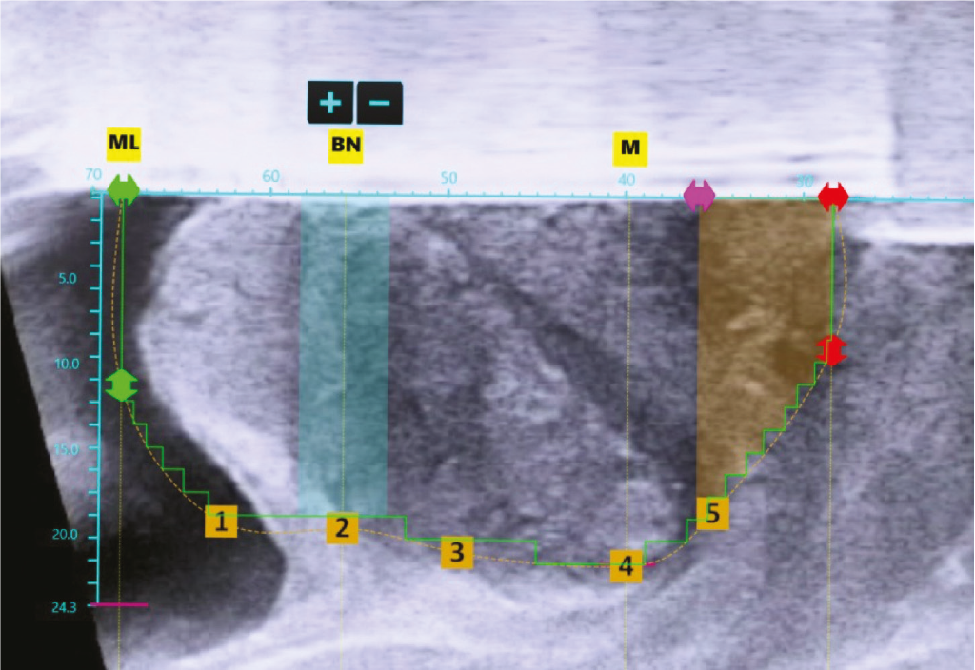
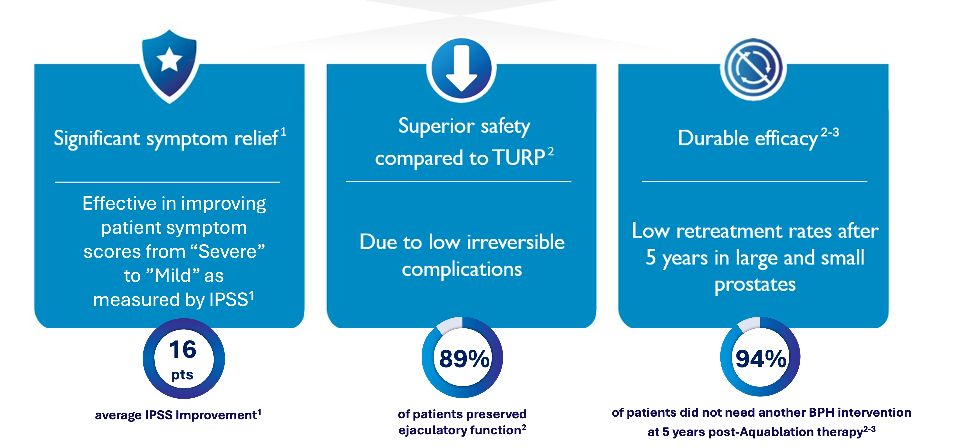
RESECT
Median lobe
Lateral lobe
RESECT
Bladder neck
Verumontanum
External sphincter
Aquablation therapy has shown in clinical trials to deliver significant, durable symptom relief while preserving sexual function & continence across prostates of all shapes and sizes¹⁻³.
Computer-assisted planning maximizes tissue resection while sparing the bladder neck, verumontanum, and external sphincter.
IPSS=International Prostate Symptom Score
Backed by
long-term clinical data
Elterman D, Gilling P, Roehrborn C, et al. Meta-analysis with individual data of functional outcomes following Aquablation for lower urinary tract symptoms due to BPH in various prostate anatomies. BMJ Surg Interv Health Technol. 2021;3(1):e000090. Published 2021 Jun 23. doi:10.1136/bmjsit-2021-000090.
Gilling PJ, Barber N, Bidair M, et al. Five-year outcomes for Aquablation therapy compared to TURP: results from a double-blind, randomized trial in men with LUTS due to BPH. Can J Urol. 2022;29(1):10960-10968.
Bhojani N, Bidair M, Kramolowsky E, et al. Aquablation Therapy in Large Prostates (80-150 mL) for Lower Urinary Tract Symptoms Due to Benign Prostatic Hyperplasia: Final WATER II 5-Year Clinical Trial Results. J Urol. 2023;210(1):143-153. doi:10.1097/JU.0000000000003483.
ML0577.B
Notes:
Slides 16-17 (Long-term Clinical Data):
Aquablation therapy is the only BPH therapy to have two FDA-studies with 5-year results showing the safety and efficacy for a broad spectrum of prostate sizes and shapes, that was also proven through Open Water Study with minimal exclusion criteria and covering a broad range of prostate sizes from 20ml to 150ml.
Although the WATER study was designed to show non-inferiority to TURP, the Study showed superior efficacy and durability for patients with prostate sizes 50-80mL
Significant symptom relief: Aquablation therapy delivers 16pts improvement from baseline at 5 years.
Superior safety: Aquablation therapy offers a lower risk of irreversible complications such as ejaculatory dysfunction.
Durable efficacy: Aquablation therapy patients have few retreatments in both large and small prostates at 5 years.

Slide 8
SYMPTOM RELIEF AND DURABILITY OVER 5 YEARS
DATA FROM TWO FDA, PROSPECTIVE TRIALS
IPSS
Retreatment due to LUTS
16pts
IPSS improvement showing significant symptom relief^{1,2}
94%
of patients did not need another BPH intervention at 5 years post-Aquablation therapy^{1,2}
Gilling et al. Five-year outcomes for Aquablation therapy compared to TURP: results from a double-blind, randomized trial in men with LUTS due to BPH, 2022 CJU
Bhojani et al. Aquablation Therapy in Large Prostates (80-150ml) for Lower Urinary Tract Symptoms Due to Benign Prostatic Hyperplasia: Final WATER II 5-Year Clinical Trial Results, 2023 Journal of Urology
ML0577.B
Notes:
Slide 18 (Symptom Relief & Durability):
Let’s dive deeper into the data behind the 2 Prospective FDA Trials.
Starting with the symptom relief, we can see that the scores at the baseline and at 5 years were mirrored for both small and large prostates, delivering a strong 16 points improvement in IPSS.
Second, 94% of men did not have further BPH intervention at 5 years again demonstrating durable efficacy in both small and large prostates.

Slide 9


CLINICALLY VALIDATED EFFICACY, DURABILITY AND SAFETY
INDEPENDENT OF PROSTATE SIZE, PROSTATE SHAPE, AND SURGEON EXPERIENCE
META-ANALYSIS
Average RESULTS across all sub-groups
4 clinical studies
425 patients
Prostate volume 20 – 150 mL
1 year follow – up
IPSS improvement | 16 points
Urinary Peak Flow Rate | 20.5 mL/sec
Quality of Life Improvement | 3.3 points
Post Void Residual Improvement | 62 mL
Ejaculatory Dysfunction | 10.8%
Erectile Dysfunction | 0%
Incontinence | 0.5%
Analysis of sub-groups:
Above or below 100 mL
Absence or presence of obstructive median lobe
OPEN WATER
Remarkable improvements across prostates of all sizes & shapes¹
FRANCAIS WATER
Elterman et al. Meta-analysis with individual data of functional outcomes following Aquablation for lower urinary tract symptoms due to BPH in various prostate anatomies, 2021 BMJ
ML0577.B
Notes:
Slide 19 (Meta Analysis):
In addition to the Efficacy and Durability scores we just reviewed, Meta-analysis from 4 studies/425 patients with 1-year follow-up demonstrated remarkable improvements across prostates of all shapes and size, including the following metrics:
Peak flow rate of 20.5 Ml/sec, 3.3 points Quality of Life improvement and post void residual improvement of 62 mL.
In addition to the Efficacy Scores, Aquablation therapy has demonstrated superior safety due to low irreversible complications such as ejaculatory dysfunction, erectile disfunction and incontinence, with 9 in 10 men preserving ejaculation.

Slide 10
Hospital Challenges
ML0577.B

Slide 11

HOSPITAL CHALLENGES
CAPACITY CONSTRAINTS
Day case surgery
1 10
Patients presented for surgery experienced a previous cancellation¹
IN
31%
of previous cancellations were due to insufficient bed capacity¹
Potential solutions
13%
of previous cancellations were due to insufficient operating theatre capacity¹
(HIT)
Hyper Intensity Theatre
D.J.N. Wong 1 2, S.K. Harris 3, S.R. Moonesinghe 1 2, the SNAP-2: EPICCS collaborators §Health Services Research Centre, National Institute of Academic Anaesthesia.Cancelled operations: a 7-day cohort study of planned adult inpatient surgery in 245 UK National Health Service hospitals, British Journal of Anaesthesia, Volume 121, Issue 4, 2018, Pages 730-738
ML0577.B
Notes:
Slide 20 (Hospital Challenges):
We know that BPH is a heavily impacted elective surgery within NHS and other public healthcare systems around the world where benign procedures can be deprioritised due to lack of hospital beds or limited theatre capacity, which are the main reasons for 1 in 10 patients presented for surgery being cancelled.
Efficiency and predictability of the Aquablation therapy system allows hospitals to tackle both problems by standardising the treatment protocol to treat more patients and discharge them on the same day, reducing the backlog.
Short learning curve enables more surgeons to have access to Aquablation therapy to treat any size or shape of prostate, minimising the need to rely on specialist services and helping reduce long waiting lists.

Slide 12
DAY CASE APPROACH
AQUABLATION THERAPY IS EFFECTIVE, EFFICIENT AND SAFE BASED ON THE INITIAL 40 CASES EXPERIENCE¹
Predictable procedure times
Effective
92.5%
Surgeries performed successfully as day case
Efficient
44min
Mean operative time
Repeatable
across variation in prostate sizes
Safe
0%
Significant complications or return to emergency department prior to TWOC
*Early findings based on 40 patients at a single site
Ng KL, Giona S, Barber N. Feasibility of Aquablation prostate surgery performed as day cases. BJU Int. 2023 Dec 20. doi: 10.1111/bju.16272. Epub ahead of print. PMID: 38117211.
ML0577.B
Notes:
Slide 21 (Day Case Approach):
Let’s review a couple of examples where hospitals were able to achieve greater efficiency through Day Case and Hyper Intensity (HIT) lists.
Day Case Feasibility study at Frimley Park, UK, has demonstrated high effectiveness, efficiency, and safety of Aquablation therapy procedure performed as Day Case, demonstrating predictable procedure times and high repeatability across variation in prostate sizes.

Slide 13



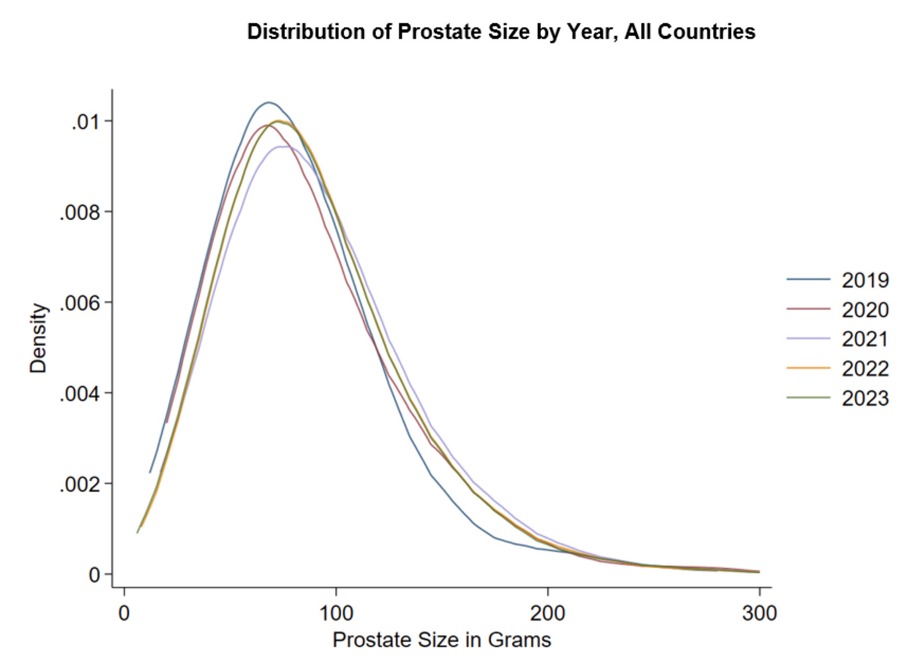
GLOBAL UTILIZATION TRENDS
  36,555 Aquablation procedures
  2019 - 2023
  Asia, Europe, & North America
  Mean prostate size: 89.7± 43.4 ml
    maximum size of 657 ml
  0.46% risk of blood transfusion or takeback for fulguration
  Distribution of Prostate Size by Year,
  All Countries
Dr. Dean Elterman observation: Aquablation therapy has shown a consistent adoption in use across a broad range prostates sizes over five years while maintaining a reasonable bleeding risk.
ML0577.B
Notes:
Slide 23 (Global Utilisation Trends):
Standardisation and high repeatability of the procedure was made possible with a Focal Bladder Neck Cautery (FBNC) protocol introduced in January 2020, which resulted in significant decline in bleeding risk requiring intervention.
In over 36K procedures performed, Aquablation therapy has demonstrated consistent adoption in use across a broad range of prostate sizes over 5 years while maintaining a low bleeding risk <1%.

Slide 14





ACTIVATING ALL 3 PILLARS OF VALUE IN BPH CARE
Hospital Value
Predictable procedure times² and low retreatment rates after 5 yeas^{1,3}
Patient Value
Clinical safety profile superior to transurethral resection of the prostate (TURP) and backed by 5-year data¹
‘The fact the Aquablation therapy is minimally-invasive and is a robotic procedure gave me a high degree of confidence.’
Chris D.55.
Surgeon Value
Treat prostates of all
sizes and shapes
Elterman D, Gilling P, Roehrborn C, et al. Meta-analysis with individual data of functional outcomes following Aquablation for lower urinary tract symptoms due to BPH in various prostate anatomies. BMJ Surg Interv Health Technol. 2021;3(1):e000090. Published 2021 Jun 23. doi:10.1136/bmjsit-2021-000090.
2. Gilling PJ, Barber N, Bidair M, et al. Five-year outcomes for Aquablation therapy compared to TURP: results from a double-blind, randomized trial in men with LUTS due to BPH. Can J Urol. 2022;29(1):10960-10968.
3. Bhojani N, Bidair M, Kramolowsky E, et al. Aquablation Therapy in Large Prostates (80-150 mL) for Lower Urinary Tract Symptoms Due to Benign Prostatic Hyperplasia: Final WATER II 5-Year Clinical Trial Results. J Urol. 2023;210(1):143-153. doi:10.1097/JU.0000000000003483.
ML0577.B
Notes:
Slide 24 (Activating All 3 Pillars of Value in BPH Care)
To summarise, new technology must deliver value to be broadly adopted in some combination of patient, surgeon or hospital value.
Aquablation therapy delivers value to all 3 stakeholders:
Patient Value: Clinical outcomes superior to TURP and backed by 5-year data, level-1 evidence
Surgeon Value: Aquablation therapy allows surgeons to treat all shapes and sizes of prostates
Hospital Value: Aquablation therapy has predictable procedure times and low retreatment rates after 5 years

Slide 15

Please review the Instructions for Use and any accompanying documentation for a complete listing of indications, contraindications, warnings, precautions, and potential adverse events.
PROCEPT BioRobotics Corporation - 150 Baytech Drive, San Jose, CA 95134 United States
© 2024 PROCEPT BioRobotics Corporation. All rights reserved. AQUABLATION, AQUABEAM, and PROCEPT BioRobotics are the registered trademarks of PROCEPT BioRobotics Corporation. ML0577.B

