Slide 1
Sustainable Business Strategy

Slide 2
Sustainable Business Strategy
Strategic Sustainable Business planning is integral to the business of the Healthcare 21 Group (HC21) which is owned by AddLife PLC. As a Nordic plc, sustainability is a central part of AddLife's vision to improve people's life by being a leading, value-creating player in Life Sciences. Operations from a sustainability perspective include aiming to be a:
Responsible Producer & Distributor
Responsible Employer
Responsible Market Participant
AddLife annually prepares a sustainability report which covers the parent company AddLife AB and its 100 subsidiaries. The purpose of the sustainability report is to provide an overarching description of AddLife’s business from the perspective of sustainability and to inform about the sustainability aspects that are necessary to understand the company’s development, position and performance, as well as the consequences of its operations.
In 2021, HC21 engaged with an independent Sustainable Business Strategist to analyse, review and develop a Sustainable Business Strategy for the Group to align with the overall AddLife Strategy. This engagement has assisted us to identify current good practices along with opportunities for improvements which are now underway. When we talk about our sustainable business, we are not just articulating our environmental efforts but also how we take care of our people and our business relationships. For this reason, our Sustainable Business Strategy takes a 3 pillar approach:
Sustainable Solutions
Sustainable Culture
Sustainable Growth
HC21 is committed to optimising opportunities to reduce the impact of our activities and business practices at every level throughout our supply chain. We are dedicated to promoting awareness and decisions that contribute to reducing our environmental impact. We will reflect our commitment to delivering sustainability in our business practices through our values and policies. We recognise this to be a continuous process of improvement rather than a steady–state and seek to improve our performance, and that of our suppliers, over time.
Note: Healthcare 21 Group (HC21), incorporating the following group companies:
Primacy Healthcare 21 Ltd, Healthcare 21 (UK) Ltd, Healthcare 21 (DE) GmbH, Tools for Living (Ireland) Ltd
Aquilant Medical (ROI) Ltd, Aquilant Scientific (ROI) Ltd, Aquilant Northern Ireland Ltd, Aquilant Ltd, Aquilant Endoscopy Ltd
Xograph Healthcare Ltd, Xograph Healthcare (Ireland) Ltd
O’Flynn Medical Ltd, O’Flynn Innovation Ltd

Slide 3
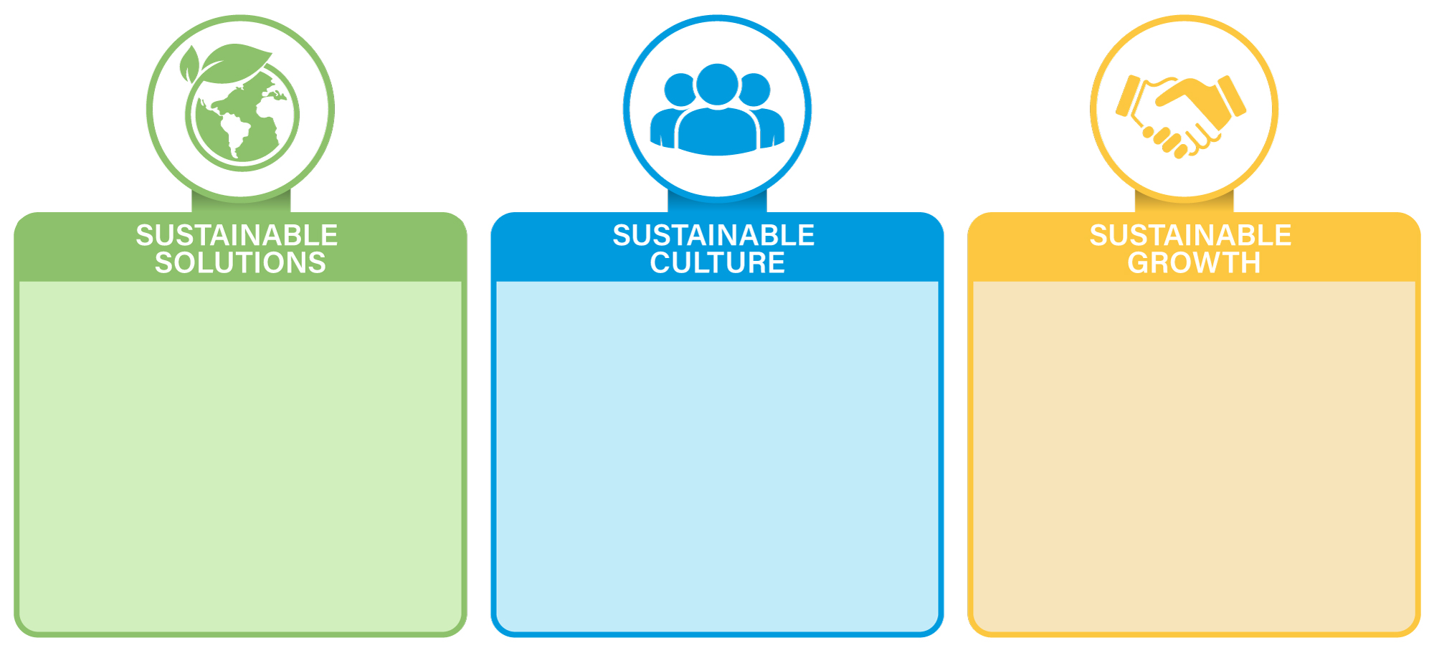
Sustainable Business Strategy - 2025
Sustainability Management
Energy Management
Company Transport
Waste Management
Water Stewardship
Circular Economy
Biodiversity
Employee Experience
Gender Balance
Business Ethics
Labour Practices & Employee Development
Sustainability Culture
Graduate Program
Health & Safety Culture
Sustainable Logistics
Sustainable Procurement
Corporate Governance & Compliance
Stakeholder Engagement
Community Engagement

Slide 4
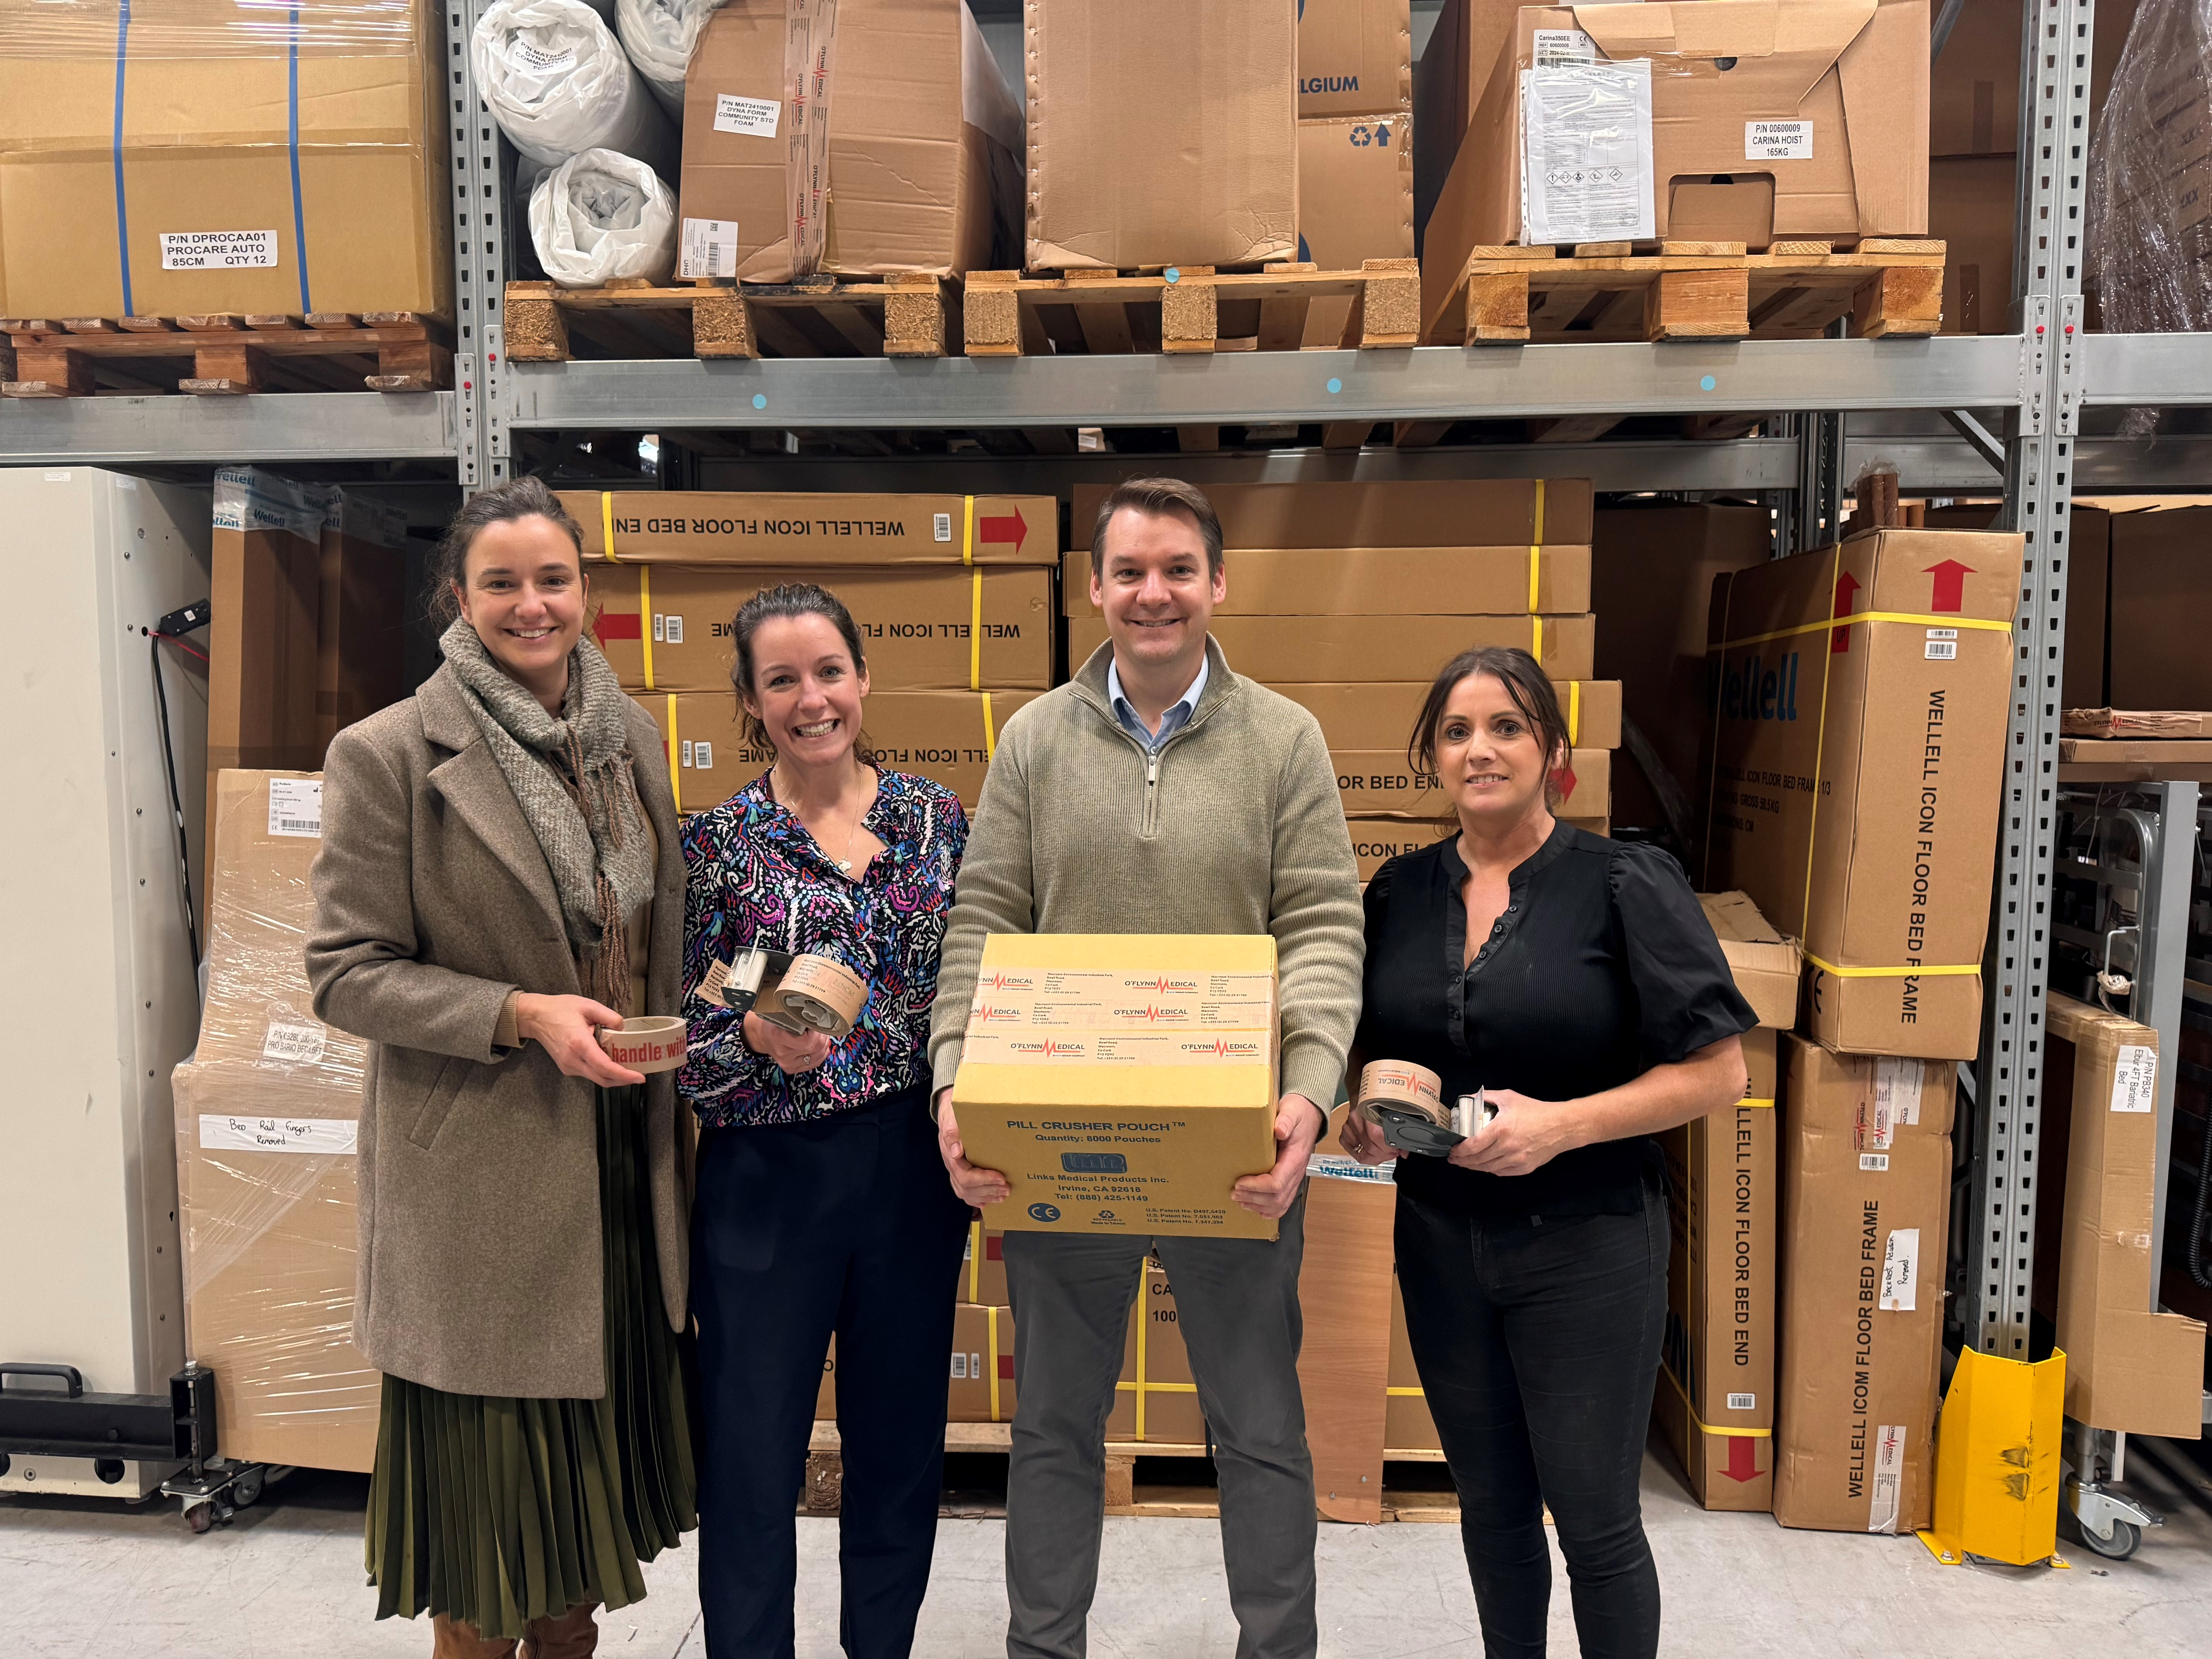

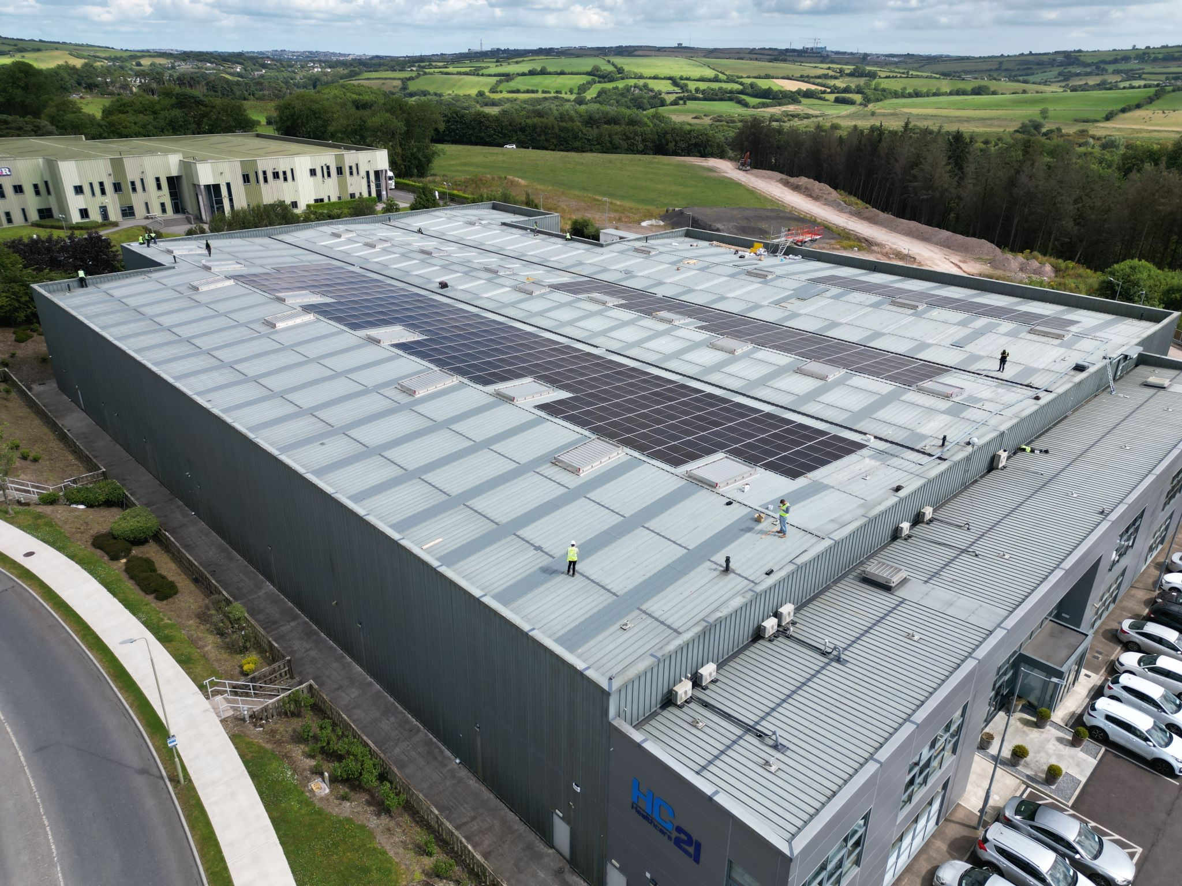
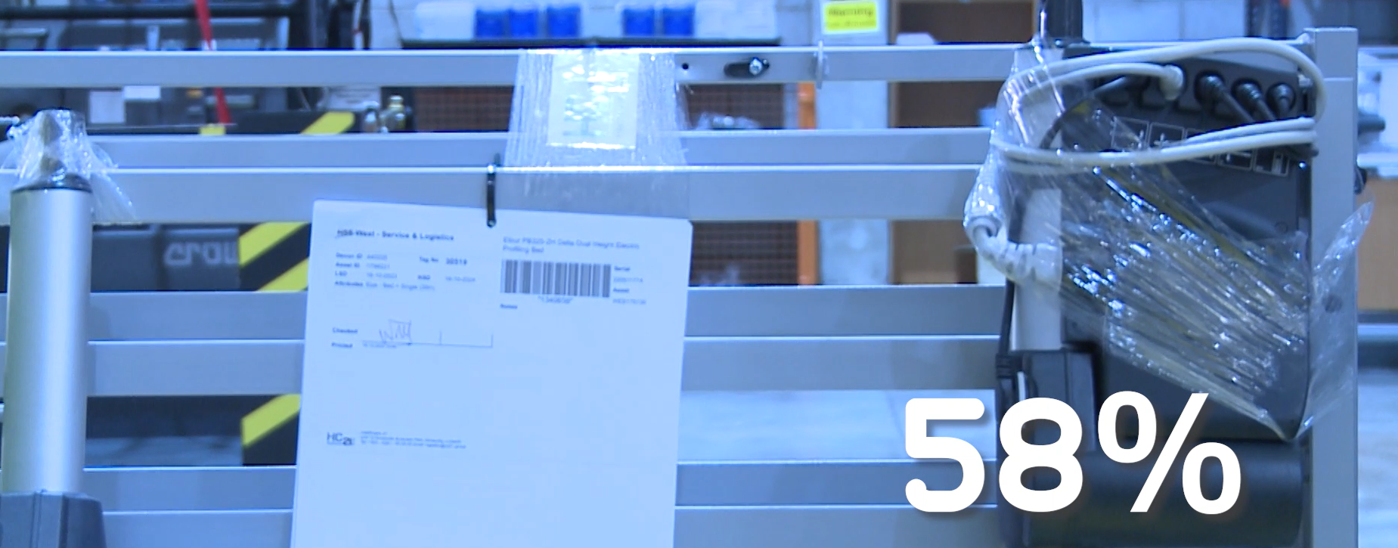
Key Initiatives to Date
Annual Carbon Reduction Plan in place (https://healthcare21.eu/carbon-reduction-plan/) declaring annual carbon emissions and target to achieve net zero by 2045
Reporting in place to annually monitor & measure our Scope 1, 2 & 3 emissions
Environmental Sustainability Group Policy in place
ISO14001 Environmental Management awarded – Maryland (Northern Ireland)
A plastic usage reduction of 58% of plastic per year has been achieved at our Recycling & Decontamination Facility
Developed online customer training platform offering convenient training to over 5,000 customers to date, reducing HC21 travel by 10,000 miles per year and CO2 emissions by 2.5 tonnes
Introduction of new technology & initiatives and collaboration with suppliers and customers has reduced our paper usage by 57,000 pages per month
Installed solar panels in HQ facility - Expected to generate 181,438 kWh/yr off setting 80% of electricity
Waste Management Team in place across all HC21 sites
All cardboard and plastic packaging waste is collected by certified company and sent for recycling
Green Car Policy in place converting fleet to greener alternatives where possible
Shortlisted as finalists in The Green Transformation Award & The Excellence in Waste Management Award at Green Awards 2024
Supplier Management Team in place ensuring we only trade with ethically responsible partners in line with ISO standards, EU Directives, Modern Slavery Guidelines and good corporate governance
Launched Healthcare 21 Cares as part of our community engagement program providing the opportunity for employees to volunteer with charities and local communities

Slide 5



Key Current & Future Focus Initiatives
Continue to replace company vehicles with greener alternatives
Explore biofuel options where infrastructure/geography cannot support greener alternative
Evaluate water use and impact across all HC21 sites & explore water harvesting opportunity where feasible
Increase awareness and appreciation of biodiversity & ecosystems service and improve biodiversity at all HC21 sites
Actively engage with customers & suppliers to review options of consolidating incoming and outgoing deliveries to optimize logistics routes, both inbound & outbound, in order to lower CO2 emissions
Reduce unnecessary packaging on HC21 outbound deliveries
Liaise with suppliers to reduce packaging where possible

Slide 6
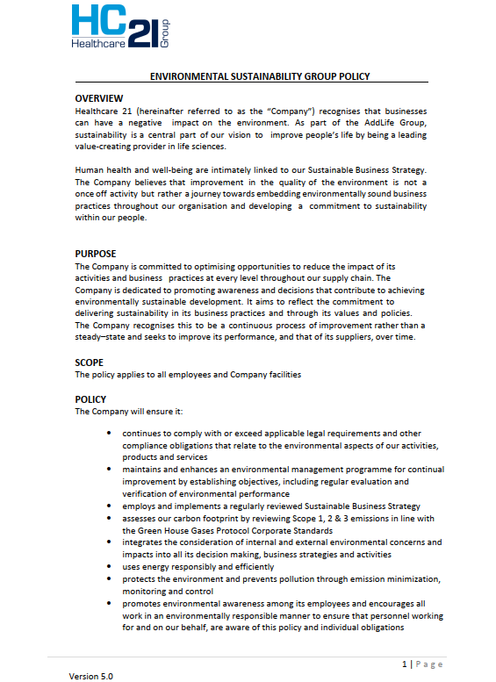
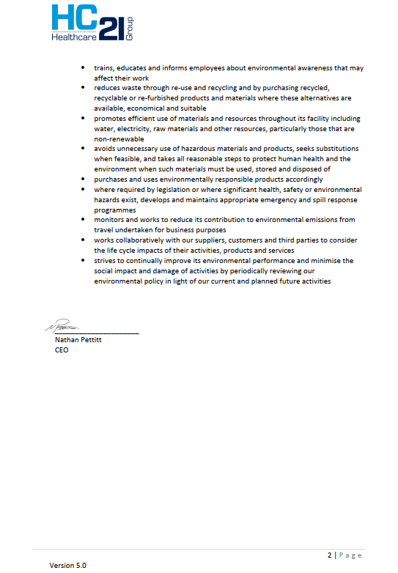
Environmental Sustainability Group Policy

